Slide 1
Functions

Slide 2


Why I use a functions instead of just coding
Pros:
If a bug occurs you can fix on 1 place
If you want to add functionality you can make a simple modification or addition in the code on 1 place (in combination with an extra parameter with default not to execute)
You have define process that can be reviewed and tested, so it helps you structure the total process and you do not have to take into account the whole process with all the diversity and exceptions.
If a new project, you can use earlier work
If coping a piece of code more then 3 times, for me it is more time efficient to make a function
Cons:
Debugging may require an extra step
(Code becomes more abstract)

Slide 3
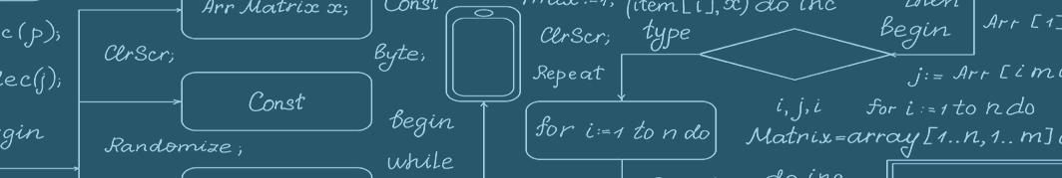
What I try to accomplice in a function
Independency of the function
No parameters/inputs that need to be retrieved from the global environment
Try to prevent to many layers (like for loop within for loop, within for loop)
Try to prevent to many (required) inputs
If a process consists out of 2 processes consider making 2 functions.
Note that some designing considerations working against each other

Slide 4

ChatGPT
Pros of using functions in coding:
Reusability: Functions can be called multiple times from different parts of the code, which saves time and effort in coding.
Modularity: Functions can be written to perform specific tasks, making the code easier to read and maintain.
Encapsulation: Functions can hide the implementation details from the user, making the code more secure and reliable.
Testing: Functions can be easily tested in isolation, allowing for better code quality and debugging.
Scalability: Functions can be combined to create larger and more complex programs.
Cons of using functions in coding:
Overhead: Using functions can add overhead to the code, which may lead to slower execution.
Abstraction: Functions can make the code harder to understand if poorly designed or if too many layers of abstraction are added.
Stack memory usage: Each function call requires a certain amount of memory on the stack, which can become a problem for programs that make a large number of function calls.
Naming and documentation: Writing good function names and documentation can be time-consuming and require extra effort.
Function dependencies: Changing one function may require changes to other functions that depend on it, which can increase the complexity of the code.

Slide 5
Needed material for the exercises
Go to UMC-Utrecht-RWE/Pfizer/Development-Interim-4 branch on GitHub and download the repo
Input data Pfizer/Documentation/Functions_instruction/Input files/
The functions Pfizer/Data characterisation/PfizerScript/p_steps/functions/
Rest of this presentation for the exercises

Slide 6
Functions
Load data

Slide 7
IMPORT_PATTERN
Purpose:
Imports groups of csv files and applies basic formatting and selection/subsetting
Appends resembling csv files to one data frame
Input: csv files
Output: data.table data frame
Parameters:
pat: A search term for the files in the folder
dir: The path of the folder you want to search in
colls: A vector of strings to indicate which column you want to import (optional)
colls.new: A vector of strings to indicate new column names (optional)
exprss: A data.table expression to subset rows
date.colls: A vector of strings to indicate date variables
append: If FALSE, checks for only 1 file in the folder. Default is TRUE.

Slide 8
Exercise or test the function as a group?
In the provided folder, there are EVENT files that need to be imported
Try to make the function work only using the required inputs
Make changes in the required inputs and see what happens (use your creativity and be curious)
Now add a not required input.
How many combinations are there? What would be the strategy to be as certain as possible that the functions does what we want?
Formulate issues for the backlog if needed (providing a reproducible scenario)

Slide 9
Backlog IMPORT_PATTERN
If folder not found NULL is returned. Add a check and provide an error message if folder is not found
…

Slide 10
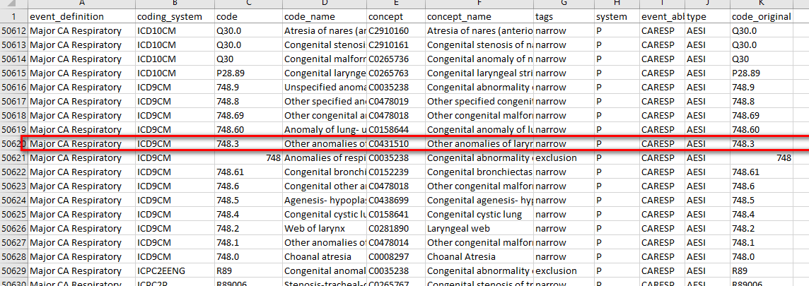
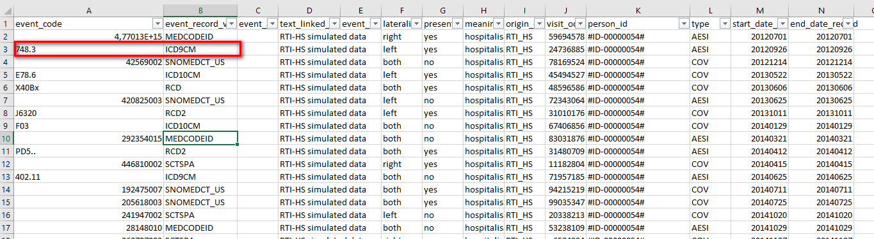
CreateConceptDatasets (input)
Codesheet
Data
P_CARESP_AESI

Slide 11
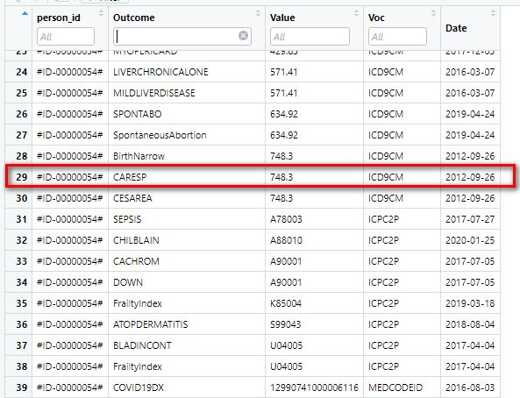
CreateConceptDatasets (output)

Slide 12
CreateConceptDatasets
Purpose:
Adding a label to all the rows that match with a code for a particular coding system. This label represents the concept/outcome.
Create a new table or set of tables with the needed information (date, person_id), in a standardized model.
Parameters:
codesheet: a data frame that contains all information regarding the codes and its connected outcomes/concepts.
c.voc, c.concept, c.codes: column names referring to the coding system, the label, and the code of the codesheet, respectively.
file or db.f.name, db.f.path: the data frame or the SQLite database that contains the data.
f.code, f.voc, f.date, f.id: column names referring to the code, the coding system, the date or the outcome/concept, and the person identifier of the data, respectively.
db or path: the path to the SQLite database or the folder where the rds files as stored.
group: a boolean that determines whether one table or multiple tables per outcome in rds or in a SQLite database file are produced.
f.name: the name of the output table if group = F.
standardized.cols: a boolean that determines whether the columns of the output table have standardized names.
Output:
One or multiple tables per outcome in rds or in a SQLite database file.

Slide 13
Exercise
In the provided folder, a file codelist is stored.
Use this codelist and the events data to create 1 table with the concepts
Change the group parameter
Change the standardized.cols parameter
(Try to create the concepts in a sqlite database https://solutions.posit.co/connections/db/databases/sqlite/)

Slide 14
Backlog CreateConceptDatasets
If the “concept” is a column name in the input codesheet then the outcome is not outputted correctly
No case sensitivity in writing .rds files while unique() is case sensitive. The unique function is used the check which concepts there are and need to be written to .rds files if group = T

Slide 15
CreateConceptDatasetsMultipleVars
Codesheet
Data
P_CARESP_AESI

Slide 16
CreateConceptDatasetsMultipleVars
Purpose:
Adding a label to all the rows that match with specified where statement. This label represents the concept/outcome.
Create a new standardized table or append to a standardized table (equal to the output of CreateConceptDatasets when standardized.cols = T and group = T).
Parameters:
codesheet: data frame with all character columns containing the coordinates of a concept in the CDM.
file: data frame object originating from the CDM.
f.id: column in the file that specifies the person id.
c.keep: The column in the code sheet that specifies the CDM column name where a relevant value is stored per concept. This is needed for categorical values.
c.columns: vector of strings specifying the CDM column names for the WHERE statement.
c.values: vector of strings specifying the values in the CDM column names (c.columns) for the WHERE statement. This vector needs to be of the same length as c.columns.
c.date: The column in the code sheet that specifies the CDM column name where a relevant date is stored per concept.
c.outcome: The column in the code sheet that specifies the concept name.
db: A DBIConnection object representing the database connection.
Output:
A table per concept in a SQLite database file (appended or created).

Slide 17
Exercise
In the provided folder, there a file additional_concepts_format is stored. Moreover, for this a function a sqlite database is demanded https://solutions.posit.co/connections/db/databases/sqlite/.
Set up a database
Try to run the function using this file
See the difference between the 2 tables that are created
Add a line for right and run

Slide 18
Backlog CreateConceptDatasetsMultipleVars
If value filled with part of Voc which is not logical and over complicating.

